Slide 1

Allotrope Framework Drives Innovation In LabInformatics
Dr. Gerhard Noelken
Allotrope BoD member, Pfizer Allotrope Liaison
Chemical Information and Computer Applications, RSC London
20 October 2015

Slide 2
MOTIVATION
THEORY
REDUCING IT TO PRACTICE
2

Slide 3

Why is access to music so much easier than access to scientific data?
Think about music...
Think about scientific data...
Music is typically stored in a small number of standard, non-proprietary
formats…
Scientific data is typically stored in a wide variety of non-standard,
proprietary formats…
.dat
.tbl
.HDF
.DAML
.LCD
.XML
.jdx
.asc
.cdf
.frx
.csv
.irf
.drdd
.pdid
.raw
…with contextual metadata that are complete, consistent & correct
…with contextual metadata that are hard to find and sometimes inconsistent
Artist
Album
Song
Genre
Date
Artwork
Material
Equipment
Process
Result
…enabling the user to find, share and enjoy it years later from any device easily!
...making it costly and sometimes difficult to find and get value from it.

Slide 4

What if scientific data was as easy to access as music?
If we...
We could...
Store scientific and process data in a standard format with contextual metadata that is...
correct
complete
consistent
compliant
Find data in seconds.
Be confident that the data that underpins our decisions is accurate, complete, and compliant.
Build data quality and data integrity into the system, eliminating the need for many SOPs and quality investigations.
Simplify, automate and improve laboratory and manufacturing processes.
Automatically create technical reports, audit trails, and substantial portions of regulatory submission documents.
Answer complex questions, not just those accessible via simple queries - by linking data from diverse, disparate sources.

Slide 5


Allotrope Foundation
Member Companies
Subject Matter Experts
Project Funding
Framework Development
Technical Leadership
Professional Software Firm
Secretariat
Project Management
Legal & Logistical Support
Partner Network
Requirements & Specifications
Contributions, PoC Applications
AbbVie
Amgen
Baxter
Bayer
Biogen
Boehringer Ingelheim
Bristol-Myers Squibb
Eli Lilly
Genentech/Roche
GlaxoSmithKline
Merck & Co.
Pfizer
ACD/Labs
Agilent
Biovia
BSSN
IDBS
Mestrelab Research
Mettler Toledo
Persistent
Riffyn
Sartorius
Shimadzu
Thermo Scientific
Waters
Erasmus Univ. Med Center
University of Southampton

Slide 6
MOTIVATION
THEORY
REDUCING IT TO PRACTICE

Slide 7

What is Allotrope Creating?
Instrument
A toolkit that enables use of the standards & metadata in software development
Application 1
Application 2
New Instrument
Metadata repository
Allotrope Foundation Framework
Reusable Software Components
File format for any technique or instrument
Standard File Format
Open Metadata Repository
Standard vocabulary & structure for metadata
.dat
Project | Test | Instrument
AF 0012354 | IR Fingerprinting | QC Lab #33B 380 FT-IR
AE0012764 | Bulk & Tapped Density | ASTM Standard Seive #6
AF 12989 | NMR Characterization | AM500
 | Tapped & Bulk Density | Sieve XXX
AF0045674 | Caractérisation RMN | Nouvelle DRX600
AF-0034558 | IR | iS10 FT-IR
.etc
.DAML
.LCD
.etc
.HDF
.tbl
.etc
.etc
.raw
.etc
.csv
.XML
.asc
.cdf
.frx
.mzML
.etc
.jdx
.adf
.irf
.pdid
With the Metadata Repository
.etc
.drdd
.etc
.etc
Project | Test | Instrument
AF0012354 | IR Fingerprinting | 380 FTIR/-SN/145453
AF0012764 | Bulk and Tapped Density | ASTM Sieve-SN/3452
AF0012989 | NMR Characterization | AM500-SN/0034578
AF0013142 | Bulk and Tapped Density | ASTM Sieve-SN/09783
AF0045674 | NMR Characterization | DRX600-SN/10234567
AF0034558 | IR Fingerprinting | iS10 FTIR/-SN/341980
.etc

Slide 8
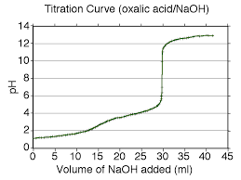
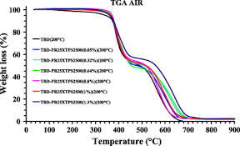
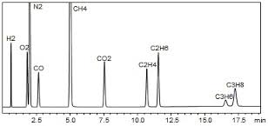
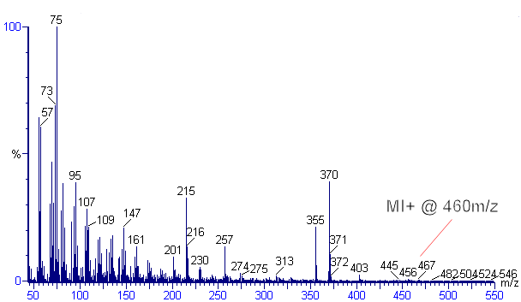
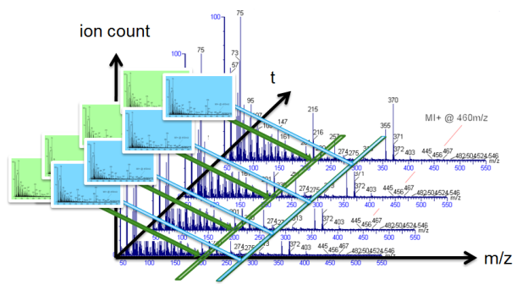
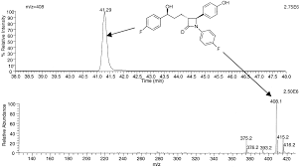
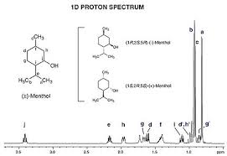
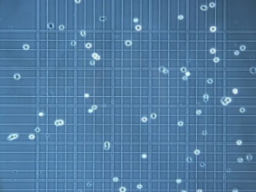
High Variability of Result Data
pH
thermogravimetry
chromatography
mass spectroscopy
HPLC-MS
HPLC-MS-MS
…
NMR
cell counter
Notes:
NMR: nuclear magnetic repulsion spectrometry
We tackle the Variability Problem of BigData.

Slide 9
Landscape of Existing Standards
NISO
LC
ISO
OAI
W3C
OASIS
IETF
OMG
CDISC
Notes:
OAI: Open Archive Initiative
LC: Library of Congress
Evaluated: MZML, AniML, BatchML, ISA S88, …

Slide 10
Key Requirements
Technical capabilities
Large data volume, small file size, fast
Platform independent
Comprehensive Metadata
Who, what, when, where, why and how
Long term data access
Documented file format
Vendor neutral format
Adaptable and extensible
Arbitrary techniques; extensible
Scientist, sample, time stamp/audit trail, instrument, purpose, method

Slide 11
Allotrope Data Format (ADF)
Contains:
Method, instrument, sample, process, result, etc.
Data cube metadata
Data package metadata
…
Allotrope Data Format
Data Description
RDF Model
Analytical data represented by one- or multidimensional arrays.
Data Cubes
Universal data container
Analytical data represented by arbitrary formats, incl. native instrument formats, images, pdf, video, etc.
Data Package
Virtual file system *
HDF5
Platform Independent File Format
Specifically designed to store and organize large amounts of numerical data.
* Use is optional

Slide 12
Allotrope Taxonomies: An Extensible Metadata Model
A library of extensible taxonomies
Uses W3C standards
Easy to understand and maintain by SMEs and Vendors
Start by harvesting existing available concepts
PSI-MS; IUPAC; RSC Chemical Methods Ontology; Dictionary of weighing terms; AnIML, etc
Reproducible & efficient collaboration model
Leverages knowledge engineers & member company scientists
2-3 weeks to develop initial version of a new taxonomy
Initial versions of 12 analytical techniques already implemented:
gas chromatography
Karl Fischer
liquid chromatography
mass spectrometry
nuclear magnetic resonance spectroscopy
thermogravimetric analysis
ultra violet spectrometry
cell counter
cell culture analyzer
blood gas analysis
balance
pH

Slide 13
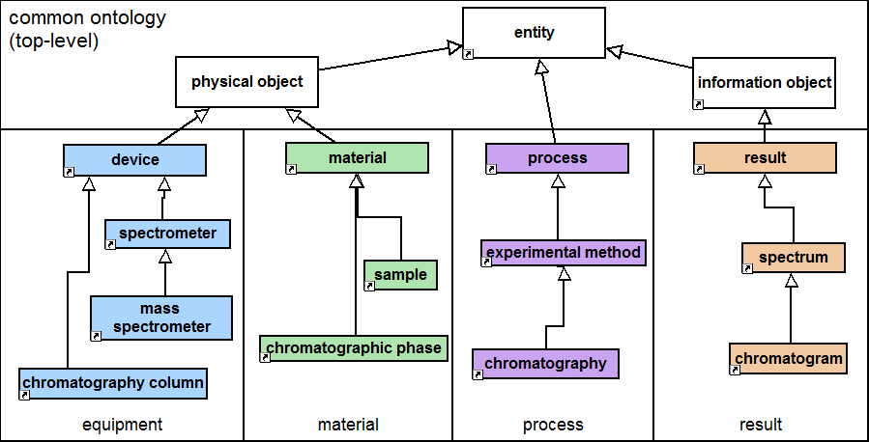
Allotrope Foundation Taxonomies
Notes:
It quickly became clear that the Analytical Chemistry Domain needed a holistic approach to the taxonomies in order to cover the broad range of techniques, but also re-use lower level concepts- to get the right level of consistency and coherence
As opposed to technique-oriented approach
Thus the support of any particular technique in the ADF draws the appropriate terms and properties from the equipment, process and result domains

Slide 14
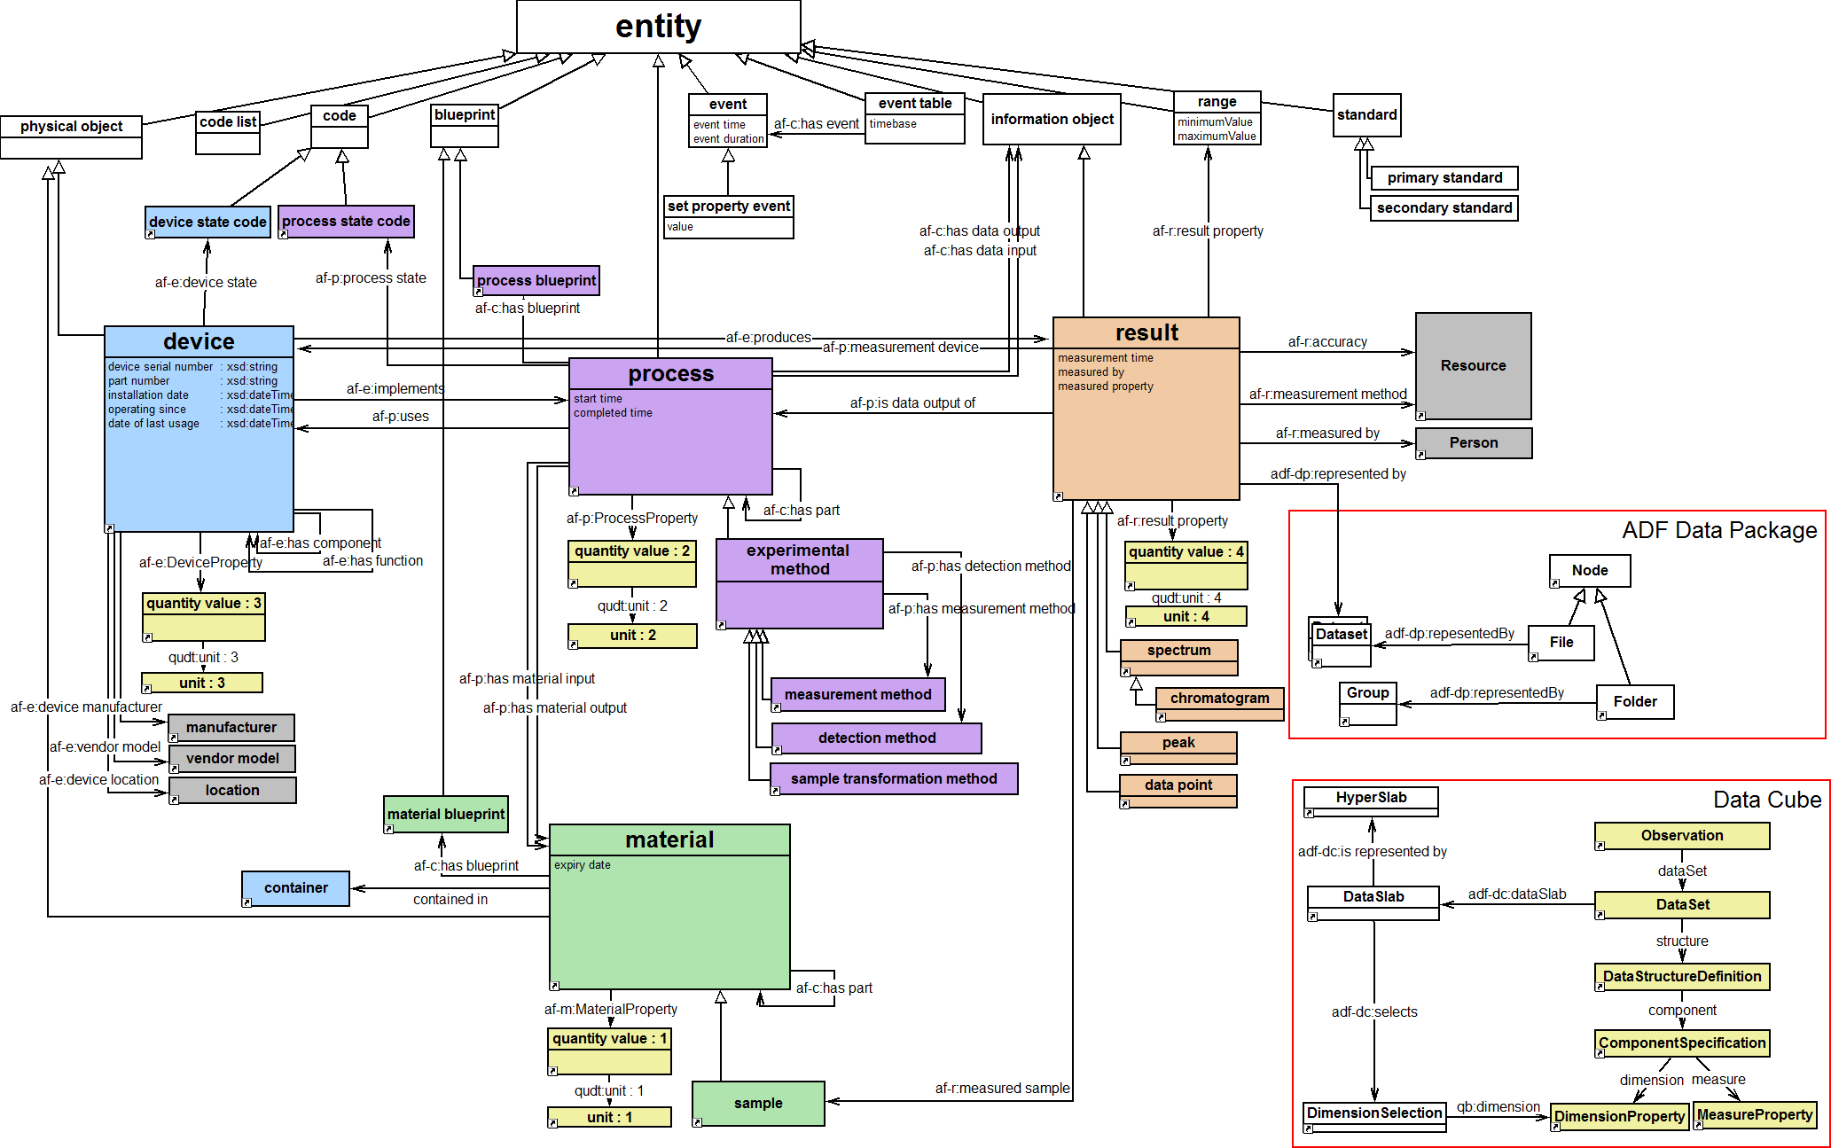
The Big Picture
ADF Data Package
ADF Data Cube

Slide 15
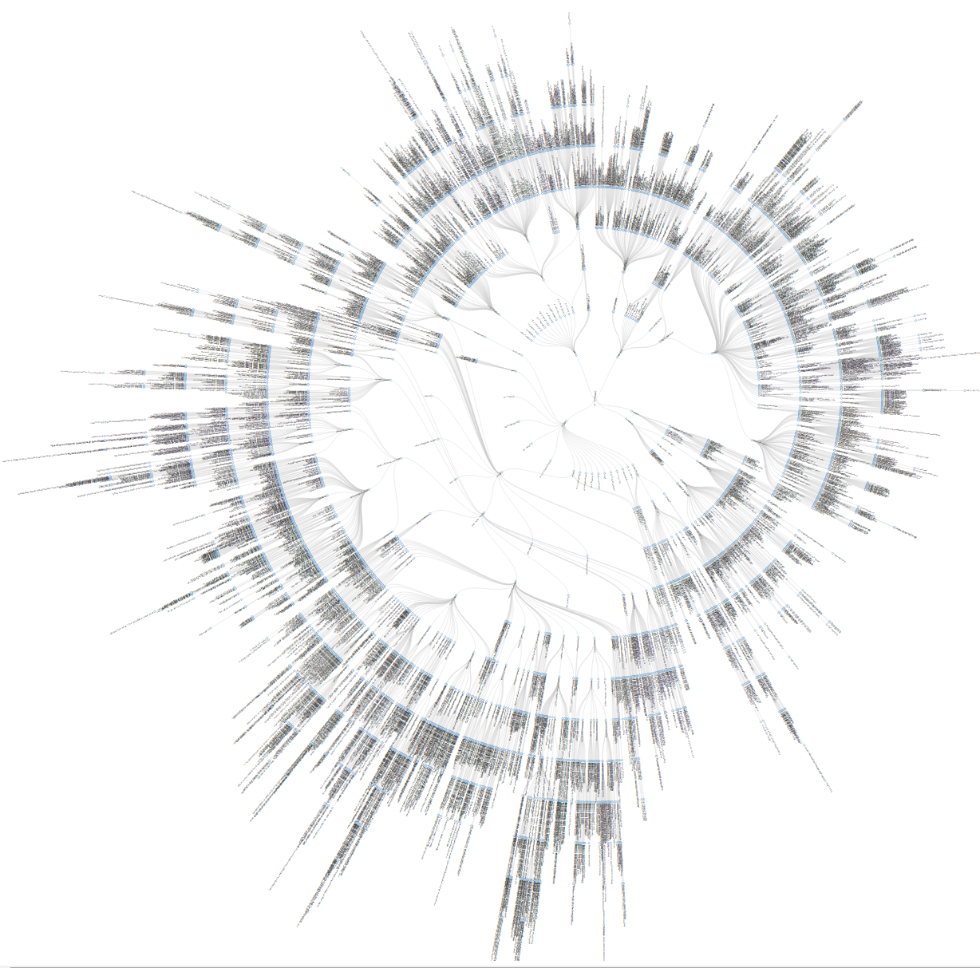
Result
Equipment
Material
Process
Common
Notes:
The key to smarter data circular dendrimer – right now about 4K entities & properties. And is growing daily.

Slide 16
ADF Class Library
Analytical Data API
Data Package API
Data Cube API
Data Description API
(Apache Jena)
Taxonomies
Triple Store API
Platform independent file format
(HDF 5)

Slide 17
RDF Data Model
Subject-Predicate-Object (Triple)
Example: <Sample 1> type <Sample> <Sample 1> createdOn ‘2015-03-13’ <Sample 1> createdBy <person X> <Sample 1> hasBarcode ‘1234567890’
Subject
Predicate
Object

Slide 18
Data Shapes Constrain How We Use Taxonomies in the Real World
Taxonomies provide an unconstrained vocabulary that we can use to describe things (instances) in our open world and give them a meaning (= what it is)
We need a mechanism to define data structures (schemas, templates) that describe how to use the taxonomies for a given purpose in a standardized (= reproducible, predictable, verifiable) way
Shapes Constraint Language (SHACL, expressed as RDF triples) is an emerging standard to do this
http://www.w3.org/2014/data-shapes/charter

Slide 19
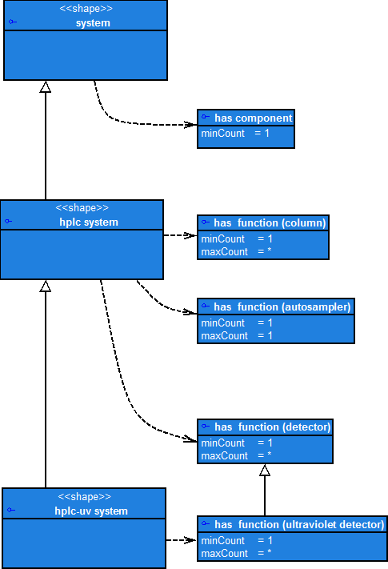
Using Data Shapes: Equipment
A system has at least 1 component
Shape hierarchies define
additional constraints
A hplc system has at least 1 component and has at least 1 column, exactly 1 autosampler and at least 1 detector
A hplc-uv system has at least 1 component and has at least 1 column, exactly 1 autosampler and at least 1 detector
and at least 1 uv-detector

Slide 20
The ADF enables a self-contained documentation of the data & metadata
Legend
Process
Step
Request
Plan Analysis
Prepare Samples
Submit Samples
Control Inst. Acquire Data
Process Data
Analyze Data
Reports Results
Store, Archive Data

Slide 21
The ADF enables a self-contained documentation of the data & metadata
Legend
Process
Step
Data & Metadata
Interoperability
(Plug & Play)
More automated reporting,
Powerful searching
Request
Control Inst. Acquire Data
Process Data
Analyze Data
Report & Share
Search & Reuse Data
Plan Analysis
Prepare Samples
Submit Samples
Control Inst. Acquire Data
Process Data
Analyze Data
Reports Results
Store, Archive Data
Analytical Method
Sample Prep Data
Instrument Instruction
Instrument Data
Processed Data
Analyzed Data
Reported Results
Stored Data
Standard data file format for data & metadata
Output from one system becomes the input to the next
The APIs enable the use of one vendor agnostic file format

Slide 22
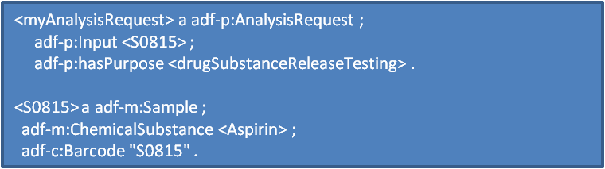
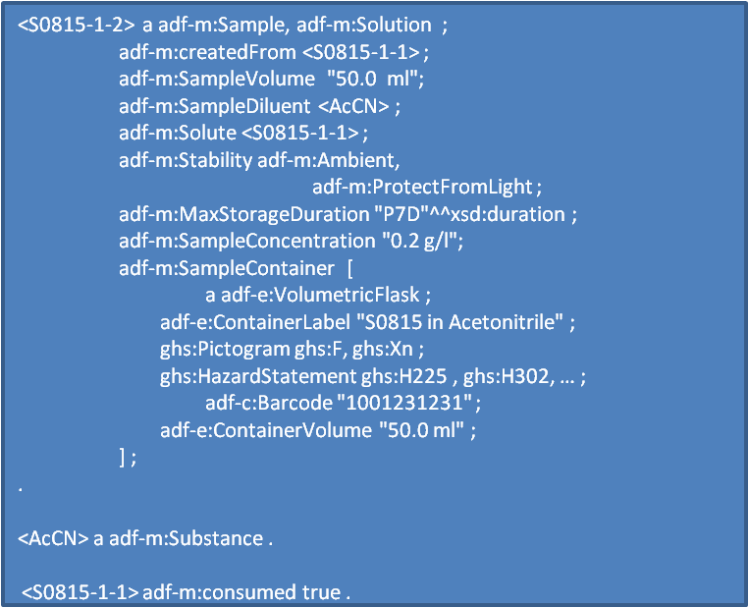
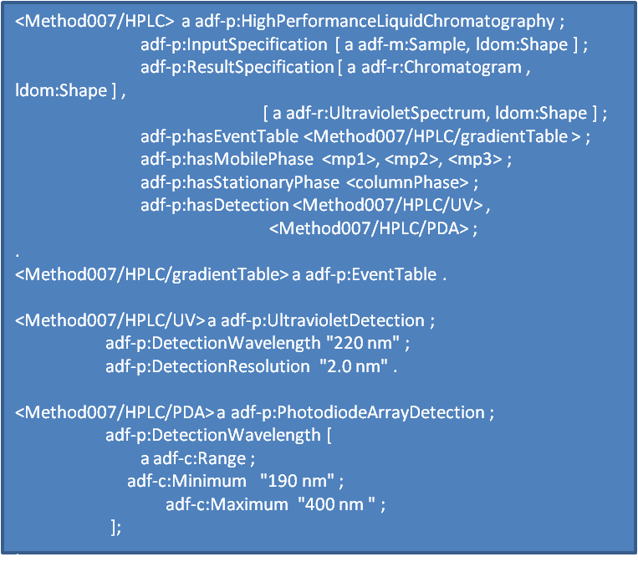
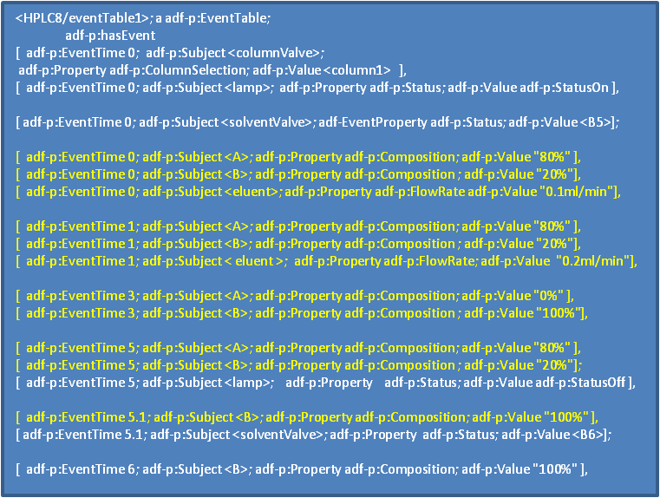
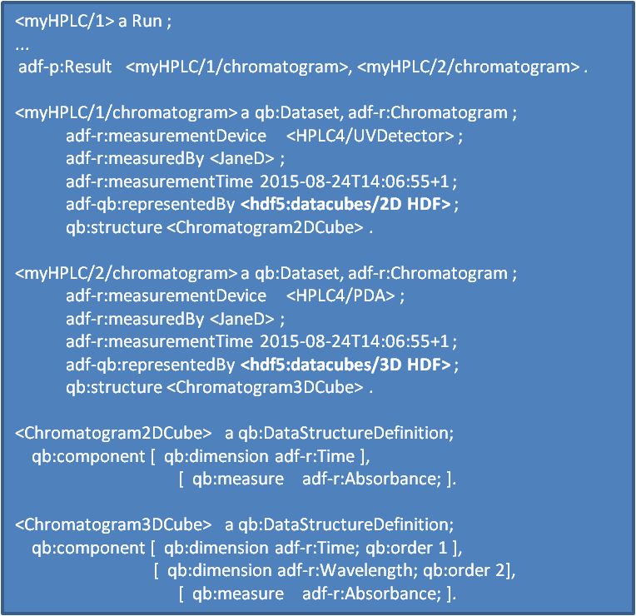
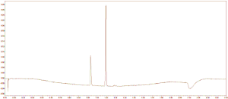




Allotrope Data Format
Data Description
Request
Sample prep
Method
Instrument instruct.
Data acquisition
Chromatogram: 2D HDF
Chromatogram: 3D HDF
Data Cubes
Chromatogram 2D HDF
Chromatogram 2D HDF
Data Package(s) (optional)

Slide 23
MOTIVATION
THEORY
REDUCING IT TO PRACTICE

Slide 24
Reducing it to practice
Integration projects:
Early adoption and acceleration of AF Framework development through delivery of Framework components.
Accelerate vendor adoption via collaboration on delivering specific capabilities through the integration projects
Ensure the validity of the Framework through real-world requirements and implementation.
Benefit the sponsoring companies in terms of shared development of new functionality & shared experience
Drive integration of the Framework into the IT/IS Roadmap

Slide 25
Current Project Portfolio
Research
Development
Commercial
Amgen
pH, Weighing, GC, Karl Fischer, TGA, NMR , Cell Density/Viability, Blood Gas Analyzer , Cell Culture Analyzer, Capillary Electrophoresis
…
Small and Large Molecule CMC
Multiple types
Baxter
Elemental Impurities
ICP-MS
Bayer
Fermentation
Process Control
Bioanalyzer
Boehringer-Ingelheim
Structure ID
HPLC-MS
BMS
Structure ID, Purification,
Lead Profiling
HPLC-UV/MS
Genentech
Assay, Purity
HPLC-UV
GSK
Drug Substance Release & Stability
HPLC-UV
Balance
Merck & Co
Method Screening
HPLC-UV/MS
Member
Instrument
non-GMP
GMP

Slide 26
Amgen Project
APN Member PoCs
AF Taxonomies
APN Member “ELN”
ADF multiple techniques
(results only)
APN Member “SDMS”
GMP Development
AF Taxonomies
pH
Weighing
HPLC
UV
MS
GC
Karl Fischer
TGA
NMR
Cell Density/Viability
Blood Gas Analyzer
Cell Culture Analyzer
Capillary Electrophoresis
…
LES
Instruments
ADF multiple techniques
(results only)
Data Lake
(Hadoop)

Slide 27
GSK Project
APN Member PoCs
APN Member “ELN”
APN Member “CDS”
ADF
APN Member “ELN”
GMP Development
ELN
Allotrope Taxonomies
Stability Testing
Release Testing Methods
SOPs
HPLC
ADF
Balance

Slide 28
The Framework will provide Business benefit
Less Manual Document Preparation
Find data quickly/logically
Eliminate Copy/paste
Improved Data Integrity
Eliminate error due to manual text entry or transcription
Seamless data exchange & with partners & CROs
One data file format
One consistent vocabulary
No more Transcription/conversion
Source agnostic
Complete, consistent, accurate metadata
Reduced cost & complexity to CROs, CMOs, partnerships
Lower Data Management Costs
Interoperability
Facilitate Regulatory Compliance
Improved instrument & software validation tracking
Extracting Knowledge & Value from Data
Remove data silos
Facilitates data mining & analytics
Future-proof against future data migrations
Reduced technical debt: no more maintenance of legacy systems
Reduced complexity in system documentation
Greatly enhance speed to answer/decision
Create an ecosystem for innovation
Simpler to support questions/investigations
Improved archiving
What are your priorities?

Slide 29

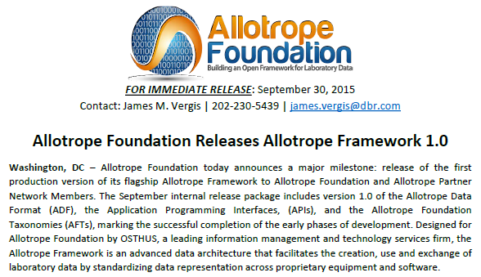
Thank you!

